Slide 1
Sequence in python Programming
Sequence in programming is a set of instructions performed in order, with each executed in turn

Slide 2
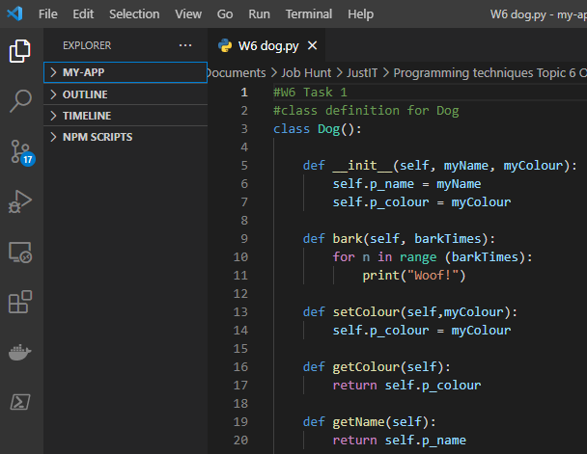
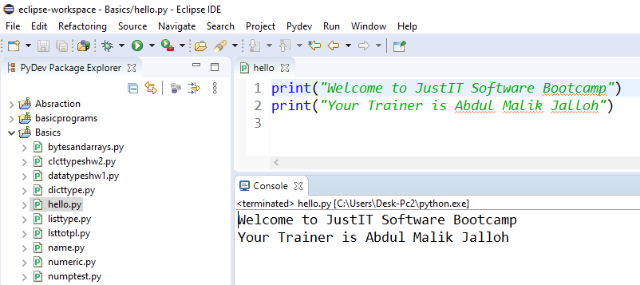
Integrated development environments (IDEs)
IDEs
IDEs were created to give programmers all the tools they needed to write programs in one place.
They allow you to write, run, and debug code without having to switch programs.
They were designed to make programming easier!

Slide 3
Programming in Python
IDEs
Python is a text-based programming language.
A program is a set of precise instructions, expressed in a programming language
Translating the programming language is necessary for a machine to be able to execute the instructions.
To execute a Python program, you need a Python interpreter (This is a program that translates and executes your Python program)

Slide 4
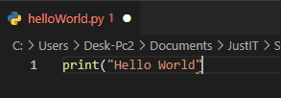

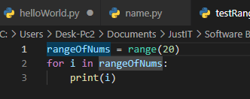
Integrated development environments (IDEs)
IDE’s Intellisense
IDE example
IDEs make it easier to write code because they provide useful tools, like syntax colour coding.
IDEs can also highlight important syntax structures to remind you to include them.
They will often automatically indent code for you. Python is very particular about indents. The IDE will remind you if it thinks an indent is required by putting one in for you.

Slide 5
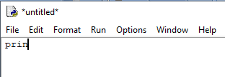

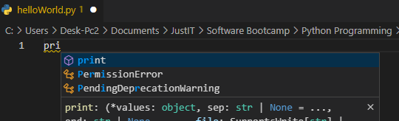
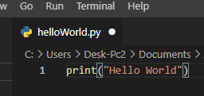

Integrated development environments (IDEs)
Basic text editor
And they can autocomplete lines of code that are typically used.
IDE Example

Slide 6
Programming Syntax
All programming languages have rules for syntax, i.e. how statements can be assembled.
All languages have rules for syntax, i.e. how sentences can be assembled.
Speech or text in a language must follow its syntax.
Programs written in a programming language must follow its syntax.
Humans can infer meaning even in cases when syntax rules are violated.
For example, “tonigth see you”, instead of “see you tonight”, will probably be understood.
Programs with syntax errors cannot be translated and executed.
In Python, you can (and you will) make syntax errors. You will need to follow the syntax rules.
Syntax errors can be frustrating when you start learning a text-based programming language.

Slide 7
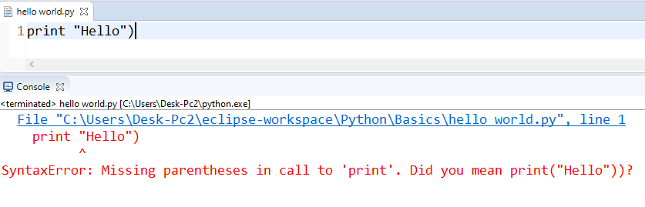
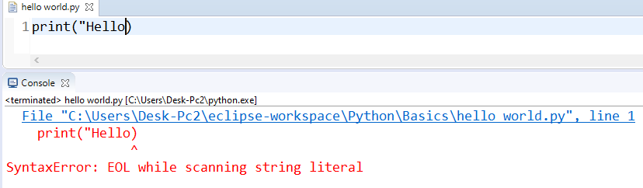
Syntax
Syntax
SyntaxError: invalid syntax
SyntaxError: Missing parentheses
in call to 'print'.
SyntaxError: EOL while scanning string literal
Don’t be overwhelmed by these errors, it is part of your learning journey. You will learn and develop the skills to debug your own code to meet and understand the python specific syntax
?

Slide 8
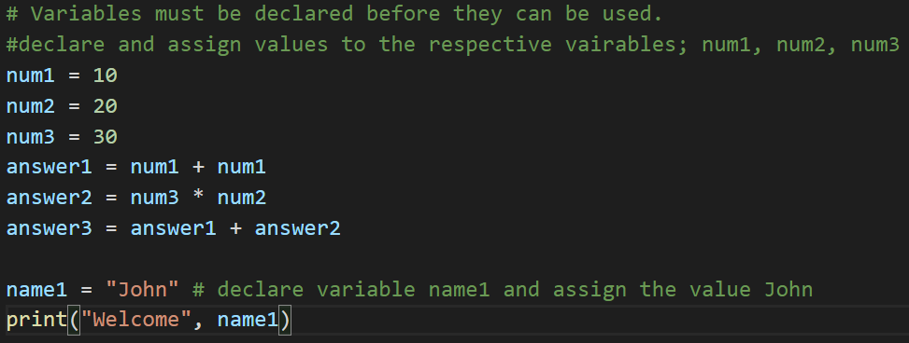
Variables
A variable holds a value in a memory location that is needed for the execution of your program.
A variable can hold one value at a time. This value can change throughout the execution of the program.

Slide 9
Variables Naming convention
Variables can be called anything you want with a few exceptions.
It must start with a letter and not a number or a symbol
It cannot contain any spaces
It must not be a word which is already used in Python such as print, input, list etc.
Ideally they should be something that makes sense to you but is not too long to type in. Often programmers use single letters such as i for an item in a list, x for a text input etc. But these can get confusing and so it is better to use a proper word.
Python is case sensitive so type them in lowercase rather than using upper and lowercase which could cause problems later on in your programming if you use the wrong case.

Slide 10
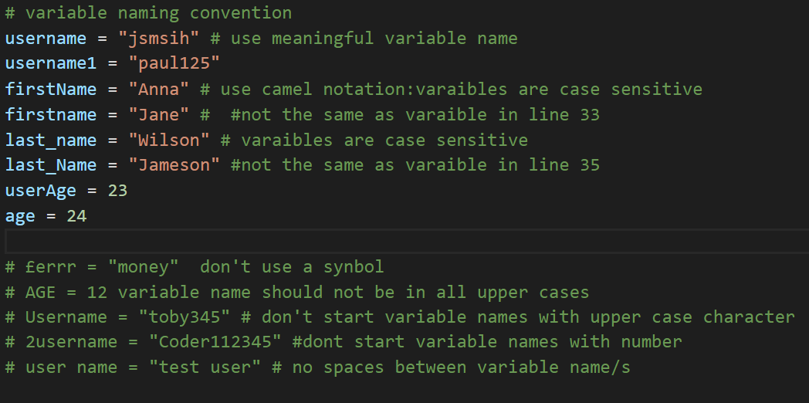
Python naming conventions
In programming, there are naming conventions that should be followed to make it easier to read and understand your code.
Python has an agreed set of conventions that programmers should follow.

Slide 11
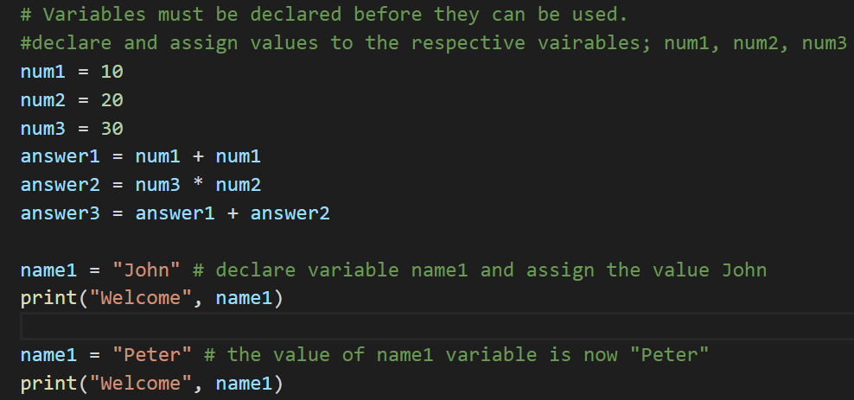
Using a variable
A memory location needs to be allocated for the variable value, before it can be used by the program.
Declaring a variable means stating what data type will be used for the value.
Initialising a variable means setting the initial value.

Slide 12
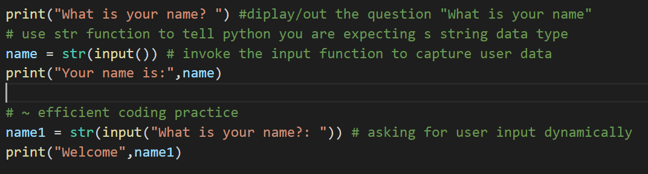
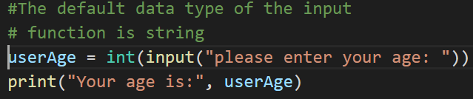
Data Types
Declaration means to declare a variable as a certain data type.
Initialisation means to set an initial value for a variable.
Assignment means to change the value held at the variable location.
A variable must be initialised before it can be used.
Meaningful identifiers are essential.

Slide 13
Data Types : Example of commonly used data types
Data types are nothing but variables you use to reserve some space in memory.
Python variables do not need an explicit declaration to reserve memory space.
The declaration happens automatically when you assign a value to a variable.
https://www.w3schools.com/python/python_datatypes.asp
Notes:
Integer
String
Boolean

Slide 14
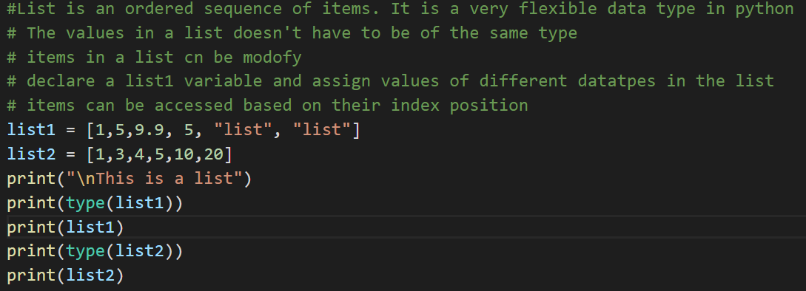
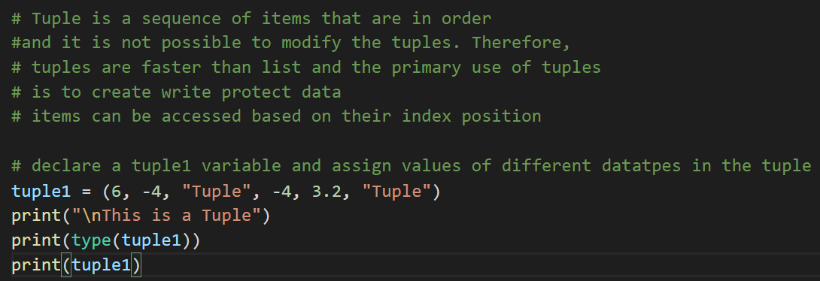
Data Types : Example of commonly used data types
Notes:
Integer
String
Boolean

Slide 15
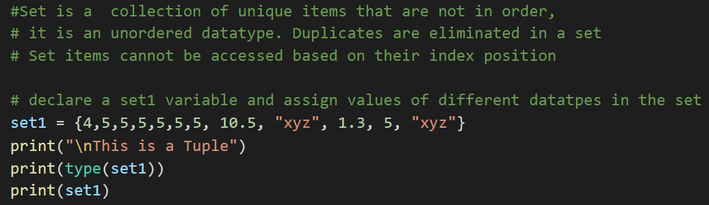
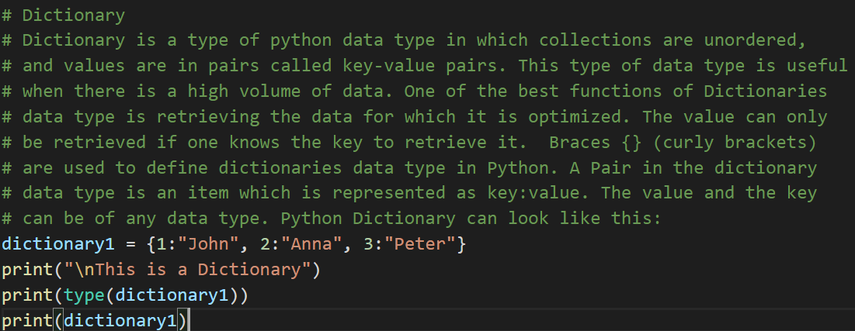
Data Types : Example of commonly used data types
Notes:
Integer
String
Boolean

Slide 16
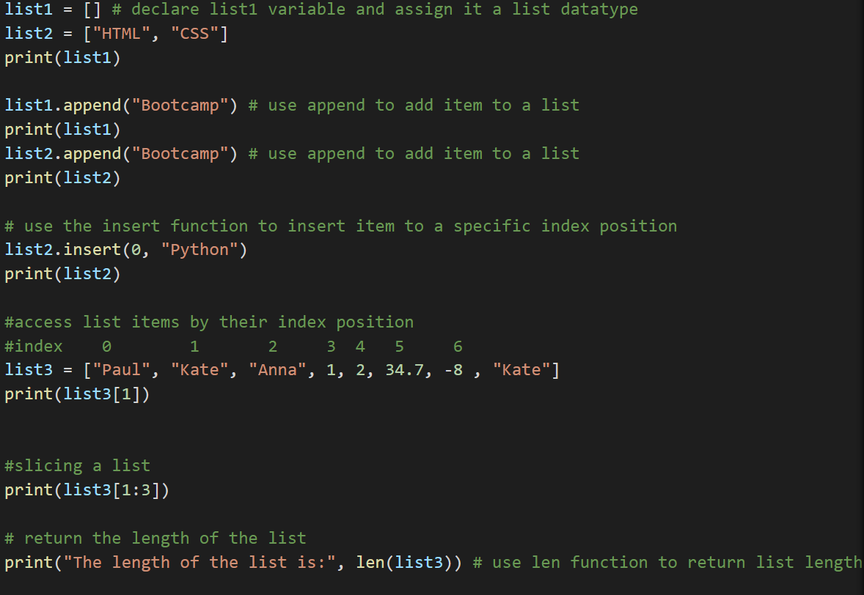
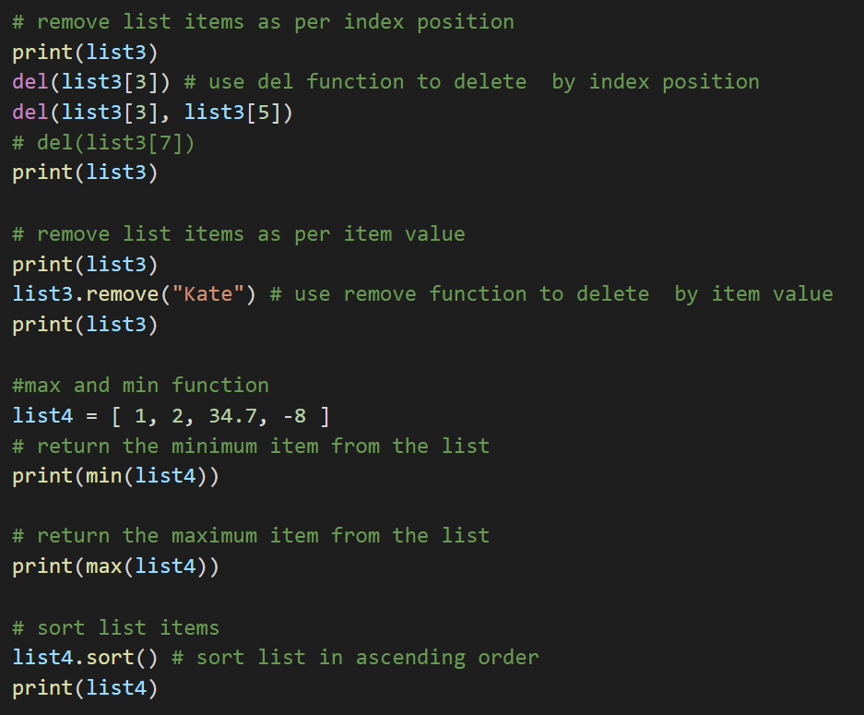
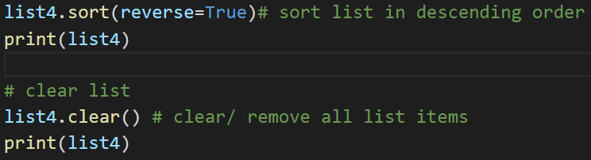
List and Strings manipulations
Notes:
Integer
String
Boolean

Slide 17
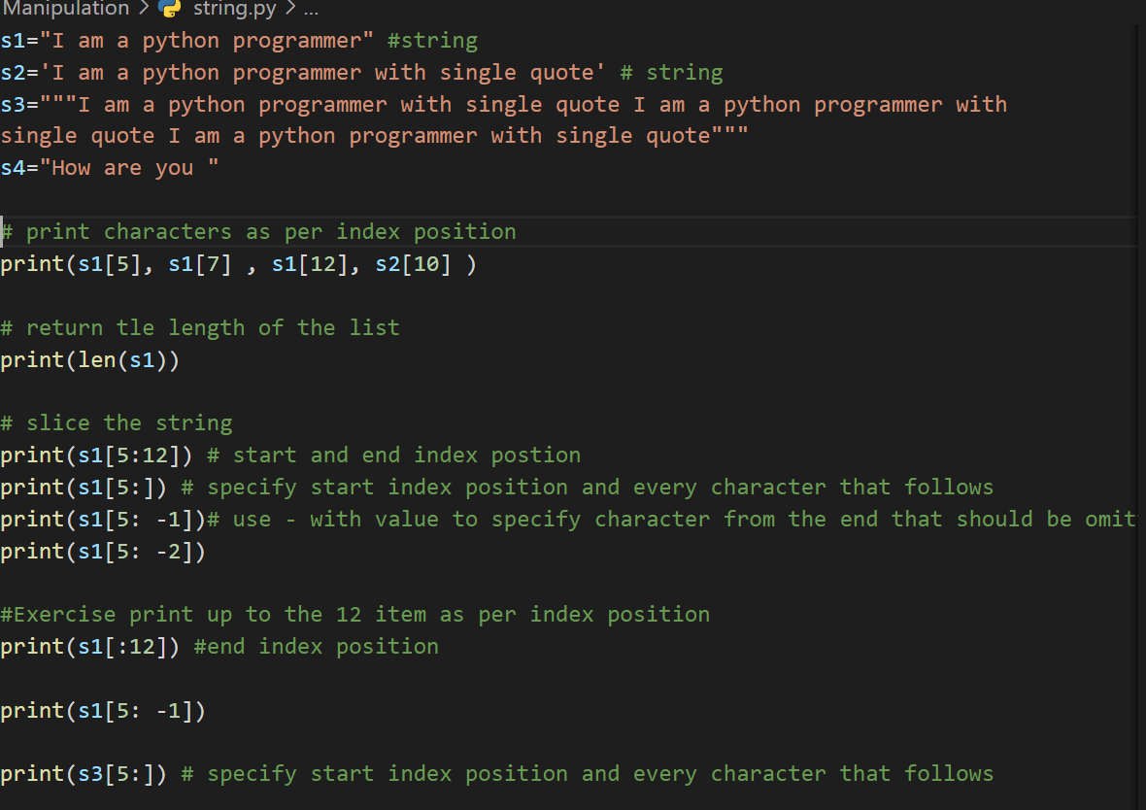
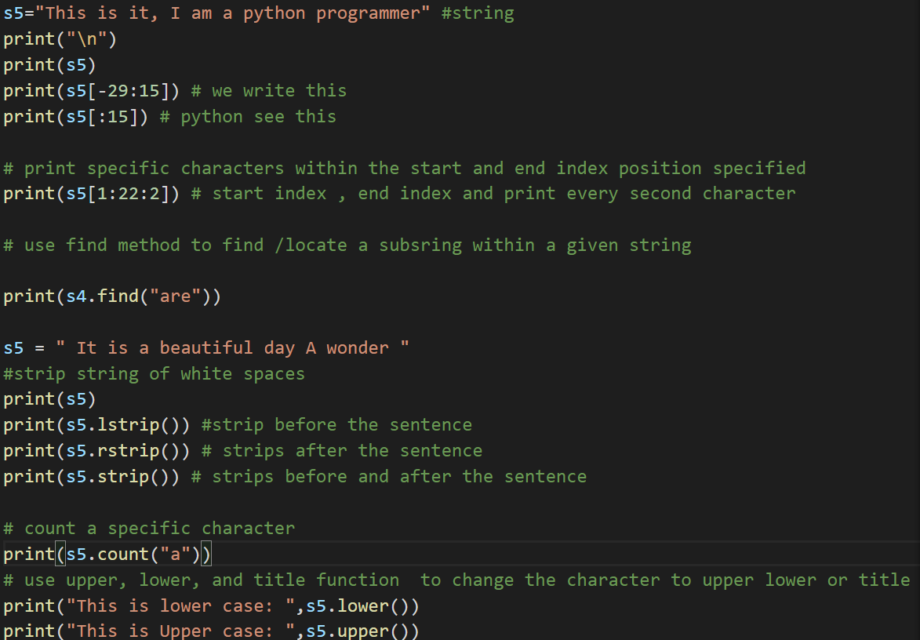
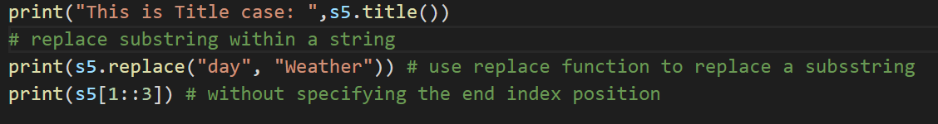
List and Strings manipulations
https://www.w3schools.com/python/python_lists.asp
Notes:
Integer
String
Boolean

Slide 18
Useful links
https://www.w3schools.com/python/python_lists_methods.asp
https://www.w3schools.com/python/python_strings_methods.asp
https://www.python.org/dev/peps/pep-0008/#function-and-variable-names
https://realpython.com/python-f-strings
https://www.w3schools.com/python/python_casting.asp
Notes:
Integer
String
Boolean

